Slide 1

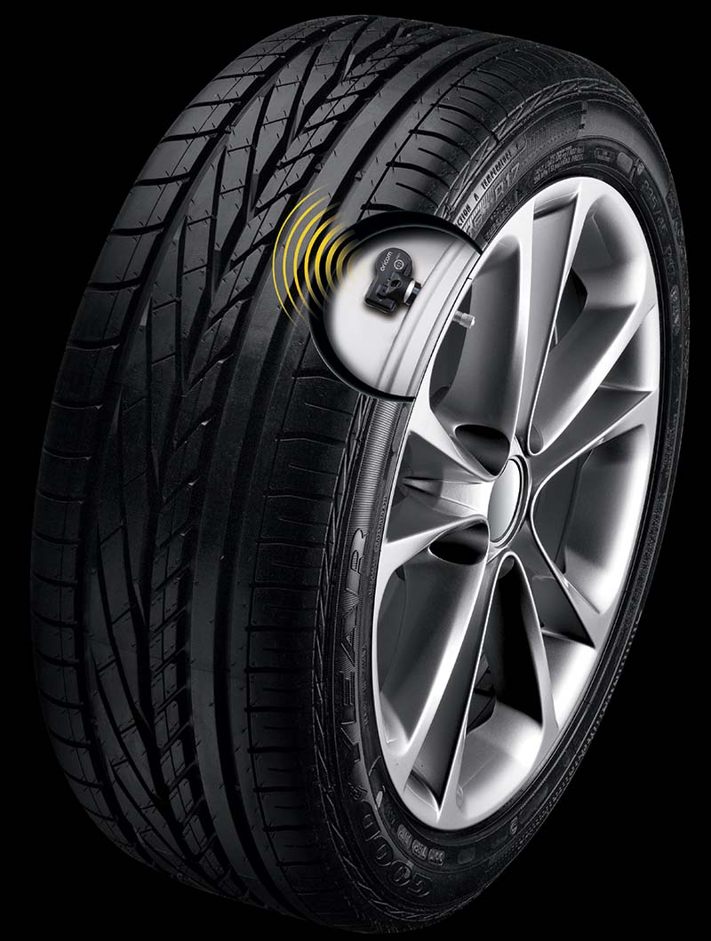
TIRE PRESSURE & TEMPERATURE MONITORING SYSTEM (TPTMS)
Nitish Patel (20BTRCO038) Sudhakar Kumar Sah (20BTRCS174) Anish Giri (20BTRCO019) Hasibullah habibi – (20BTRCO051)
Guided by,
Ashish Kumar Singh

Slide 2




TEAMS
NITISH PATEL
ANISH GIRI
Analysis & Management
Process & Methodology
SUDHAKAR KUMAR SAH
HASIBULLAH HABIBI
Work on Sofwares
Take care of Hardwares

Slide 3
TABLE OF CONTENTS
02
03
05
06
01
INTRODUCTION
04
OBJECTIVES
LITERATURE SURVEY
SETUP
DETAILS OF HW/SW
07
08
09
VIDEO DEMO
PROTEUS
SIMULATION
ARDUINO
OUTPUT
REFERENCES

Slide 4
01
INTRODUCTION
Basic history and introductory part

Slide 5

INTRODUCTION
Some studies have indicated that close to 10% of all highway fatalities can be linked to low tire pressure
Tire pressure monitoring system were originally developed in the 1980s for use with run flat tires
In 1990s low tire pressure in was identified as a primary factor in hundreds of fatal SUV rollover accidents
Direct TPMS to be required on all cars and light trucks sold in the United States after Sept 1,2007

Slide 6
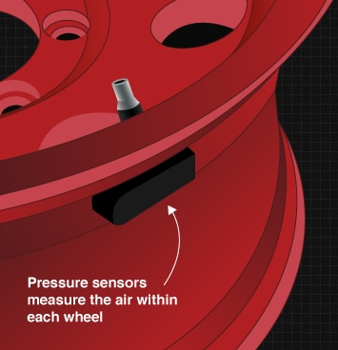
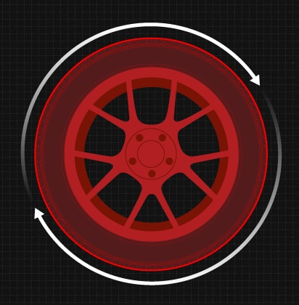
Indirect TPMS
Direct TPMS
Tire pressure measured from rate of wheel revolution
May be inaccurate if new tires are a different size
Typically less expensive than direct TPMS
Must reset after every tire rotation and/or inflation
Actual tire pressure readings
More accurate than indirect TPMS
Battery lasts about a decade
No need to reset after tire rotation & inflation

Slide 7
02
OBJECTIVES
Different objectives explained

Slide 8
OBJECTIVES
The objective of the Tyre Pressure Temperature Monitoring System in the vehicle is to warn you that at least one or more tyres are significantly under-inflated, possibly creating unsafe driving conditions. TPTMS sensors in the vehicle show a warning light when tyre pressure drops to 6-7 PSI(pounds per square inch).
We will be using Embedded C language, Arduino Uno board as microcontroller, MPX4115A pressure sensor and LM35 as temperature sensor. we will also make Splunk enterprise account on web to collect and manage data from the wifi module attach on the Arduino board.

Slide 9
03
LITERATURE SURVEY
Surveys reports

Slide 10
LITERATURE SURVEY
SN | NAMES | DESCRIPTION | DATE | AUTHORS | ADVANTAGES | DISADVANTAGES
1 | Wireless tire pressure monitoring system for motor vehicles. | is designed to monitor tire pressure of any type of vehicles with the help of wireless network and wireless charging/remote charging | 2017 | Snehal r javhari, Biplap k, Bhej raj singh patel | wireless charging methodology is used | Can’t be applied for old vehicles
2 | Model tire pressure sensor id learning method using fuzzy logic. | the fuzzy logic algorithm is proposed for the method of auto-learning sensor ID’s | 2017 | Adnan Shaout and Victoria Yanez | auto-learning of sensor IDs | only output variable is the sensor state
3 | Tire location registration algorithm using interframe spacing pattern in Tpms. | proposes the conventional tire location registration algorithms which uses the Inter Frame Spacing Pattern to identify the location of each tire by the Global Identifier | 2017 | Chu Kyun Bae, Sol Lim, Seung Gi Kim and Dae Jin Kim | system uses pressure and acceleration Sensors | Each sensor should use different Inter Frame Spacing Pattern
4 | Implementation of a car model for indirect pressure monitoring system. | software implementation for an indirect Tire Pressure Measurement System based on the Anti-lock Braking Systempresent in a car | 2016 | Antoniu Miclaus, Rajmond Jano and Gabriel Chidris | uses the real-time controller and a Simulink model | Each wheel rotational speed is according to the acquired data

Slide 11
04
SETUP
System Architecture

Slide 12
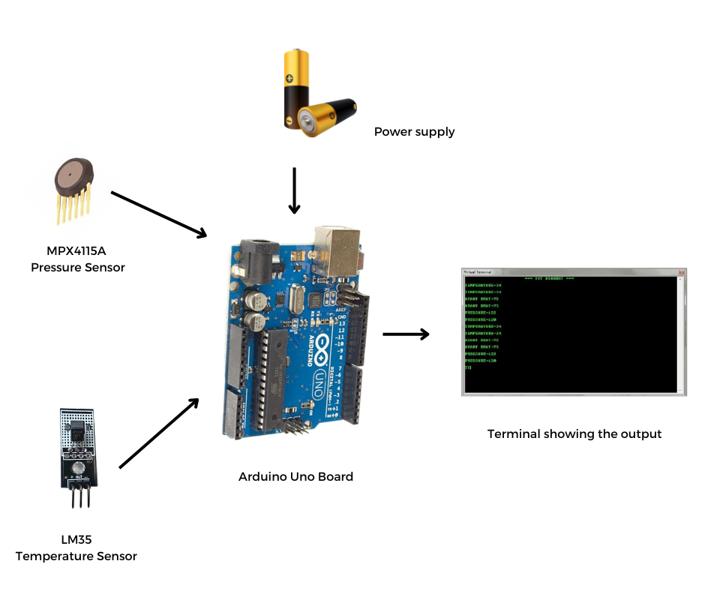
SETUP
Fig : Expected Experimental Setup For Proposed System

Slide 13
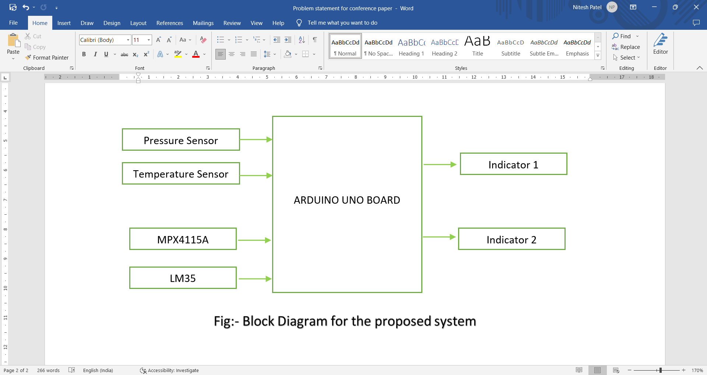
PROPOSED METHOD
Arduino UNO board is used as computer microcontroller
MPX4115A pressure sensor measures pressure in Kilopascal & upto 5-115 kpa pressure range
LM35 temperature sensor measures the temperature from -55 to 150 degree celcius temperature.
Total Cost of the project would be approx. RS 6k IC.

Slide 14
Advantages of Direct TPTMS
Disadvantages Of Direct TPTMS
Deliver actual tire pressure readings from inside the tire
Not prone to inaccuracies because of tire rotations or tire replacements
Simple resynchronization after tire rotation or tire replacements
Batteries inside the sensors usually last for about a decade.
May be included in a vehicle’s spare tire
More expensive overall than an indirect TPMS
Though simple, resynchronization may require costly tools.
Battery rarely serviceable; if the battery is drained, the whole sensor must be changed.
Proprietary systems make installation, service, and replacement confusing for consumers and auto shops.
Sensors are susceptible to damage during mounting/demounting

Slide 15
05
Hardware & Software requirements
Materials used for proposed method

Slide 16

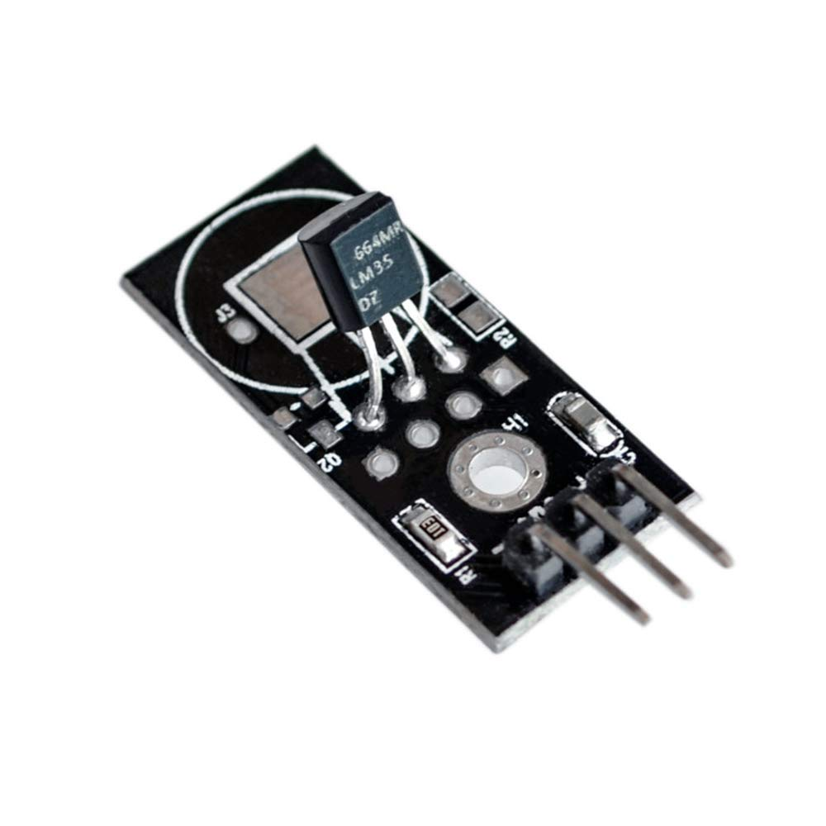
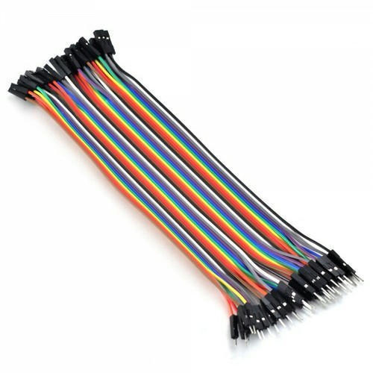
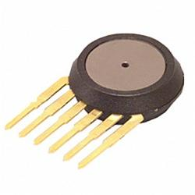
HARDWARES
ARDUINO UNO
Microcontroller used as computer
LM35
Temperature sensor
CONNECTING WIRES
For connecting all the hardwares together
MPX4115A
Pressure sensor

Slide 17
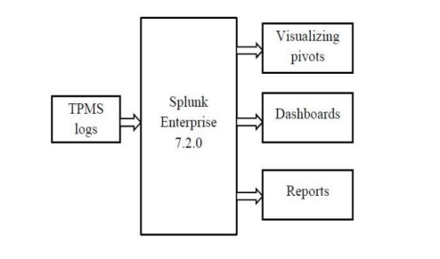
SOFTWARES
Splunk Enterprise 7.2.0 is used to collect,manage and analyze variety of data
Visualization pivots helps to communicate complex ideas and data patterns with clarity and precision
Dashboards includes searches,visualizations and input controls that captures & present the available data
Reports are based on single searches and can include visualizations
App examples:- splunk forwarder, apps browser
Fig: Block Diagram of the Log Management process in Splunk Enterprise

Slide 18
06
VIDEO DEMO
A Demo Video

Slide 19
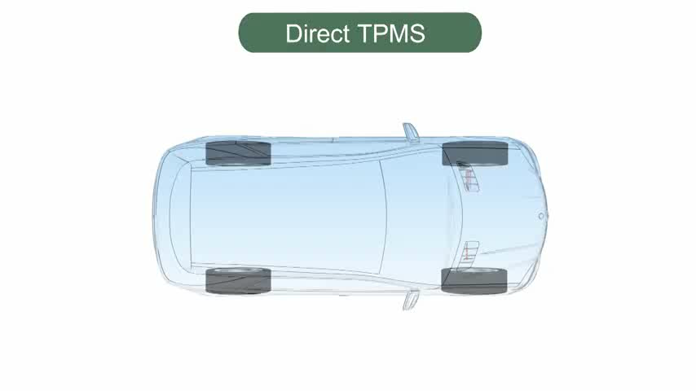
DEMO
A relevant video demo is shown in the box for the proposed method of our PCL project i.e. Direct TPTMS.
We have extracted the similar video demo of our project from youtube. :XD

Slide 20



User receiving data on Phone
Stored on cloud
Manage the data
Data collected at Receiver
End user

Slide 21
07
Proteus Simulation
A simulated picture of the proposed system

Slide 22
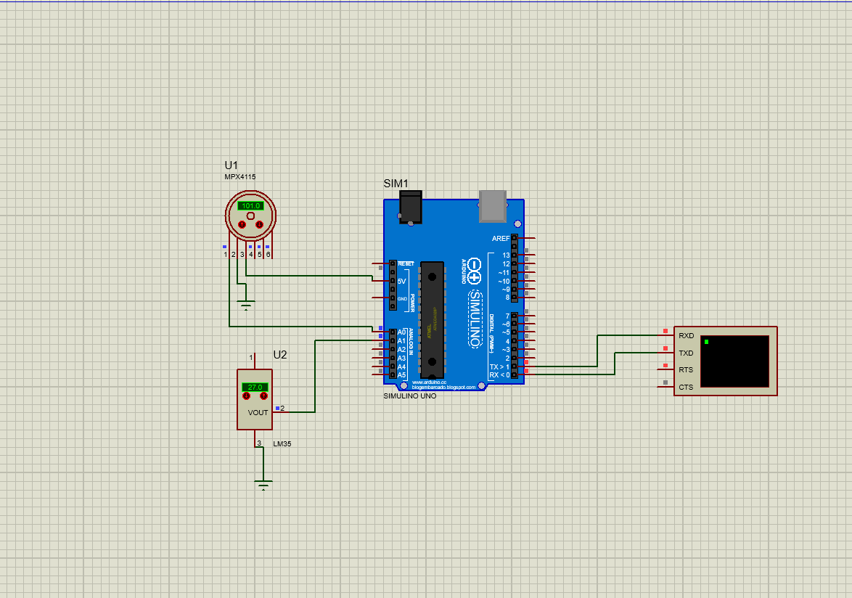
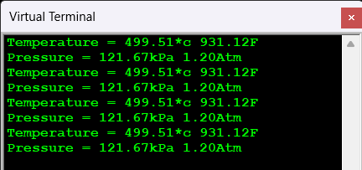
Fig: Proteus simulation for the proposed system

Slide 23
08
Arduino output
The output seen in the Arduino app monitor window

Slide 24
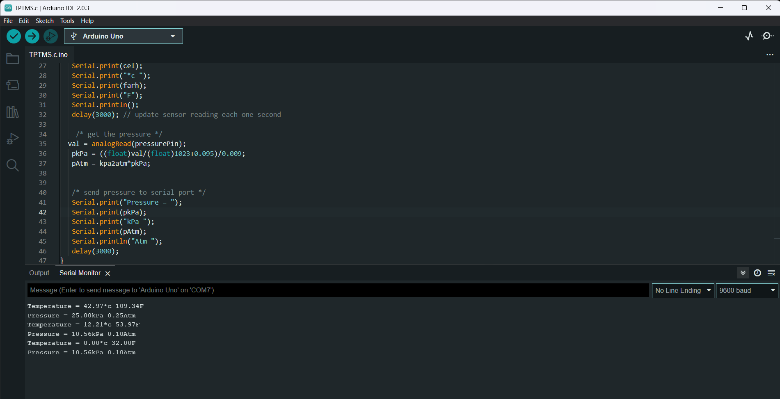
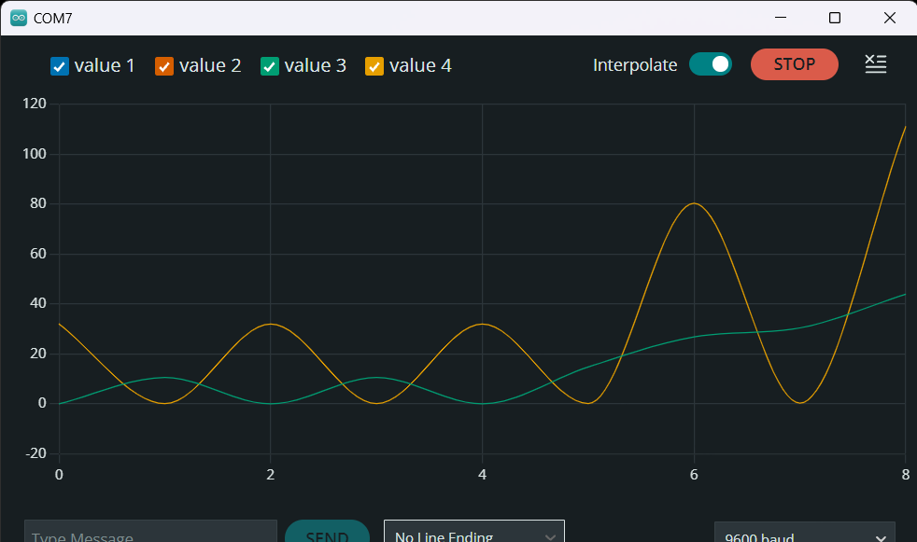
Arduino outputs
Fig: The ouptut seen serial monitor of arduino app
Fig: The ouptut seen serial plotter of arduino app

Slide 25
REFERENCES
S. Abdelhamid, H. S. Hassanein, and G. Takahara, “Vehicle as a Mobile Sensor,” Procedia Computer Science, vol. 34, pp. 286–295, Jan. 2014. [Online]. Available: http://www.sciencedirect.com/science/ article/pii/S1877050914008801
Snehal R.Javheri, Biplap Kumar and Bej Raj Singh Patel, “Wireless Tire Pressure Monitoring System for Motor Vehicles”, International Conference on Ubiquitous and Future Networks (ICUFN), pp. 744-748, June 2017
Sharmila and Vibin Mammen Vinod, “Design of a Real-Time Tire Pressure Monitoring System for LMV’s”, International Conference on Green Engineering and Technologies (IC- GET), pp. 103-106, 2016
Nouman Naim Hasan, Adeel Arif, Muhammad Hassam, Syed Shabeeh and Usman Pervez, “Implementation of Tire Pressure Monitoring system with Wireless Communication”, International Conference on Communication Computing and Control Applications, 2011

Slide 26
THANKS! 😊
ANY QUESTIONS?
PRESENTED BY:-
ANISH GIRI.
Nitish Patel
Sudhakar kr. sah
HASIBULLAH HABIBI

